Slide 1
Summary Report: NPN Social Media Activity
January 2023 through September 2024

Slide 2
Overview
CDC works with partners across the United States to address alcohol and other substance use during pregnancy and fetal alcohol spectrum disorders (FASDs)
CDC’s FASD National Partner Network (NPN) organizations use social media to communicate with their audiences about substance use and FASDs and collaborate with each other
ORAU performs social media monitoring to enhance and evaluate the outreach and communication efforts of NPN organizations
This report summarizes
ORAU’s bi-monthly FASD NPN Communications Bulletin issues 1 – 10
An analysis of all NPN posts related to prenatal alcohol and polysubstance use and FASDs from January 2023–September 2024
A detailed analysis of social media posts from September 2023–September 2024 using the hashtag #FASDNPN, designed for messages related to NPN topics

Slide 3
Summary of FASD NPN Communications Bulletins 1-10

Slide 4
About the Communications Bulletin
Purpose:
Highlight project-related social media messages
Encourage cross-promotion
Promote resource sharing
Amplify consistent messaging
10 issues distributed bi-monthly to NPN partners and FASD allies via e-mail from April 2023 to October 2024
Social media messages and information related to:
Resource development
Social media impact (Instagram, Facebook, X/Twitter)
Educational initiatives and events
Awareness, advocacy, and observance efforts
Community engagement and support
Collaborations and partnerships
Research and knowledge sharing
Quick tips
Announcements
Promotion of CDC Let's Talk Materials and the FASD NPN Toolkit

Slide 5
FASD NPN Toolkit Updates
FASD NPN Communications Bulletins highlight updates and expansions to the FASD NPN Toolkit.
December 2023:
Toolkit launched with materials for Birth Defects Awareness Month, a 2024 observances calendar, and Let's Talk QR Code Business Card
February 2024:
Introduced a Social Media Misinformation Log Template
April 2024:
Released the FASD NPN One-Pager for raising awareness about the NPN
June 2024:
Added several exhibit booth materials (magnet, booth banner, flyer, pocket card, badge card)
August 2024:
Featured MSU/NACCHO’s palmcard promoting their new communication guide
September 2024:
Announced AAP’s FASD Resource Toolkit
https://orau.gov/FASDChampions

Slide 6
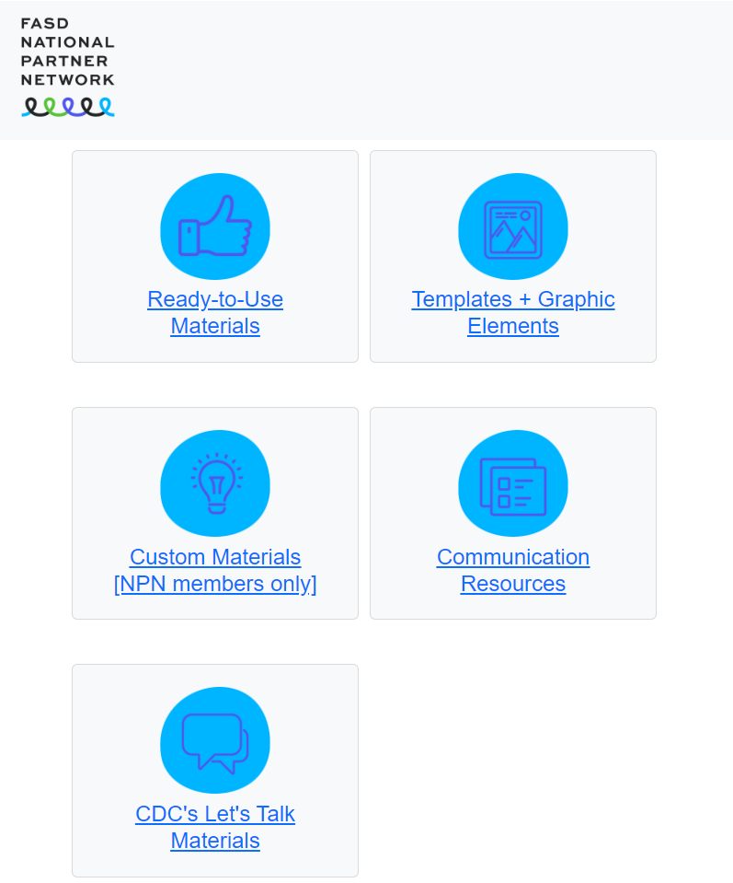
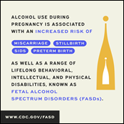
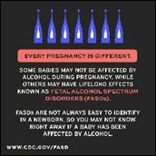
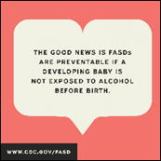
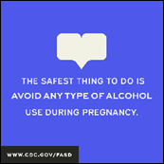
FASD NPN Toolkit
FASD National Partner Network Toolkit
Comprehensive Toolkit: Hosted on ORAU servers, the Toolkit includes resources for FASD awareness, education, and prevention
Regular Updates: Continually updated with new resources
Collaborative Development: Showcases the collaborative efforts of NPN members and partners in creating actionable, prevention-focused resources for healthcare professionals and the broader community.
Toolkit Promotion to NPN: Communications Bulletins marked the Toolkit’s launch, highlights, and updates
https://orau.gov/FASDChampions

Slide 7
Quick Tips
The Quick Tips section of the bulletin provides valuable insights into effective social media management, content creation, and collaboration within the FASD NPN.
3 Tips for Writing Effective Social Media Captions
3 Ways to Avoid Social Media Scheduling Tool Pitfalls
The Best Time to Post on Social Media
Social Media Best Practices for Handling and Responding to Negative Comments or Misinformation
Recognition of FASD Awareness Month with the FASD NPN Partner Toolkit
Promoting NPN collaboration by including resources on the toolkit's Ready-to-Use Materials webpage
Encouragement to continue using #FASDNPN on posts

Slide 8
NPN Content Stream
The bulletin’s Content Stream section aggregates social media posts from NPN accounts on Instagram, Facebook, and X/Twitter.
Content Stream Topics:
NPN Products, Events, Services, and Trainings
Posts promoting project-related materials, events, and services provided by NPN organizations
Recognizing Awareness Days and Observances
Posts recognizing 22 different awareness days, weeks, and months
Educating and Awareness Raising
Posts disseminating information and raising awareness about FASDs, the importance of alcohol-free pregnancies, new research findings, and educational resources
Promoting Let's Talk Materials
Posts highlighting Let’s Talk social media posts, videos, fact sheets, infographics, and more

Slide 9
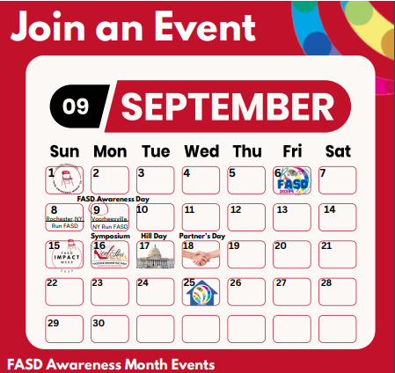
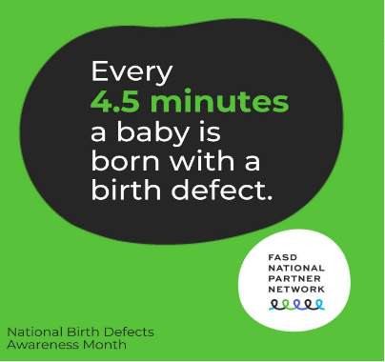
Awareness Events Spotlighted
NPN Recognition ‡
Observance or Awareness Day/Week/Month | Month | 2023 | 2024
Birth Defects Prevention/Awareness Month* | January | 2 | 11
National Women Physicians Day | February |  | 2
World Birth Defects Day | March | 1
National Drug and Alcohol Facts Week | March |  | 7
St. Patrick’s Day | March |  | 1
National Nutrition Month | March |  | 2
Alcohol Awareness Month | April | 6
National Women’s Health Week | May | 2 | 2
National Alcohol and Other Drug-Related Birth Defects Awareness Week | May | 1
Summer and Fourth of July | June-August | 1
National Children’s Awareness Month | June |  | 1
National Children’s Day | June |  | 1
Disability Pride Month | July |  | 1
National Parents’ Day | July |  | 1
National Back to School Prep Day | August |  | 1
FASD Awareness Month/Day | September | 14 | 16
Halloween educational messages | October | 2
Medical Assistant Recognition Day | October | 1
International Day of Persons with Disabilities | December |  | 1
NPN recognized 22 awareness days, weeks, and months
9 observances in 2023
13 observances in 2024
FASD NPN Toolkit includes a calendar of suggested observances
Bolded events were observed by more than one NPN organization
‡ Number of partner organizations that recognized each awareness event. Project recipients and national partners are counted individually.

Slide 10
🌟 Collaboration Spotlights 🌟
FASD NPN Communications Bulletins highlight four types of collaboration.
Types of collaboration*
Partner on developing communication products or presenting at events (e.g., conference presentations)
Promote CDC communication products by developing and posting an original social media post
Amplify other NPN organizations’ products or events by re-sharing social media posts highlighting them.
Promote communication products or events of other NPN organizations by developing and posting an original social media post
* Collaboration is defined as an activity occurring between two different project recipients/national partners.

Slide 11
Collaboration Highlights
NPN Organization | Collaboration Highlights
FASD United | 12
ORAU | 9
ACOG | 7
NASW/UT-Austin | 5
UAA/AWHONN/ NPWH | 5
MSU/NACCHO | 4
AAFP | 4
AAP | 3
UNR/MAP | 3
Grand Total | 52

Slide 12
Collaboration Highlights
40 original social media posts and re-shares about communication products or activities of other national partners: 27 original messages 13 re-shares

Slide 13
Collaboration Highlights
NPN Organization | Promotional Messages Posted
MAP | 8
FASD United | 3
MSU/NACCHO | 2
UAA/AWHONN | 1
ORAU | 1
Grand Total | 15

Slide 14
All NPN Social Media Posts

Slide 15
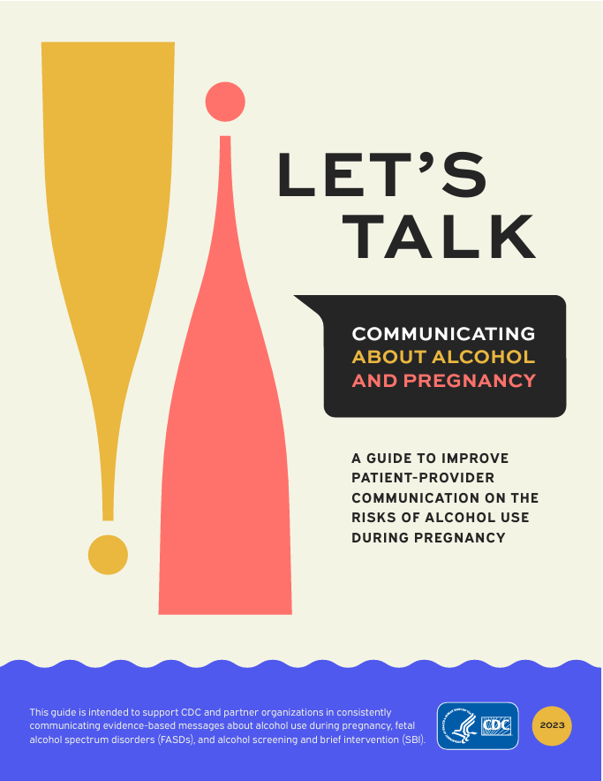
All NPN Social Media Posts
Social media monitoring occurred from January 2023–September 2024
Includes social media posts from NPN organizations about prenatal alcohol and polysubstance use and FASDs
11 Instagram accounts
13 Facebook accounts
10 X/Twitter accounts
2,426 total posts
26,106 engagements (likes, comments, and shares)

Slide 16
NPN’s Posts and Engagements by Month on Instagram, Facebook, and X
Most posts occurred in September 2023, followed by September 2024; both during FASD Awareness Month
The most engagements happened in March 2024 and September 2024
National Drug and
Alcohol Facts Week

Slide 17
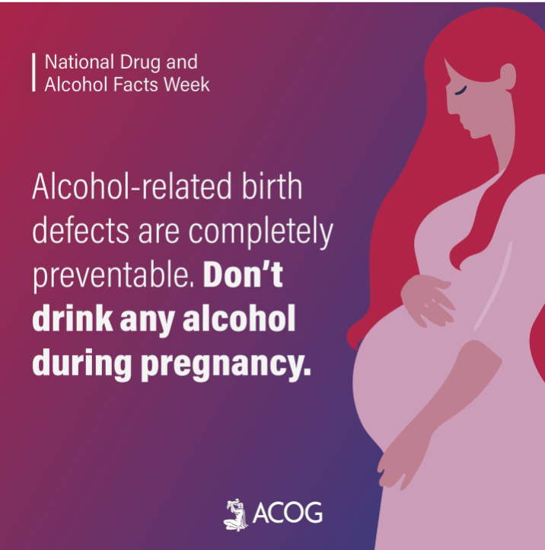
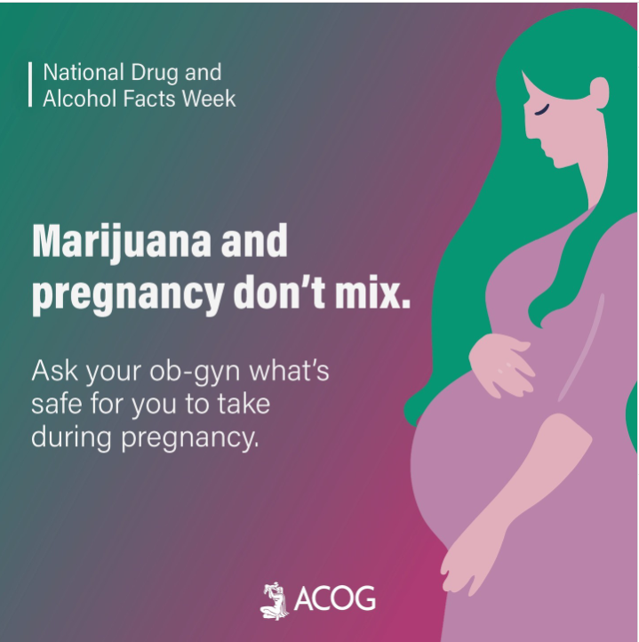
NPN’s Top 5 Most Engaging Posts Were on Instagram and Came From @acog_org
The top 2 posts occurred during National Drug and Alcohol Facts Week (March 2024)
ACOG – 1,405 engagements; Comments highlight the need for better support and harm reduction strategies for addiction during pregnancy.
ACOG – 842 engagements; Comments highlight concerns over evidence, demand further research on marijuana in pregnancy, and point out shaming and a lack of harm reduction information.

Slide 18
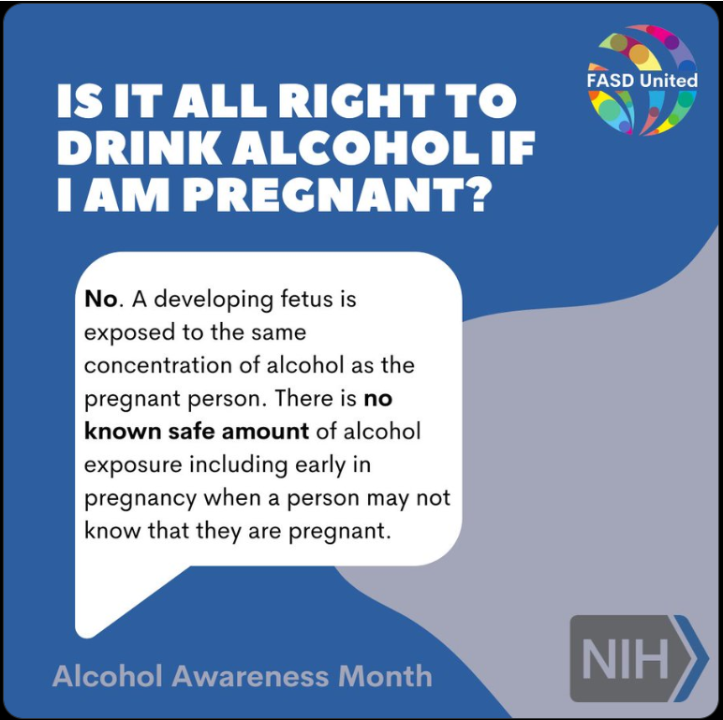
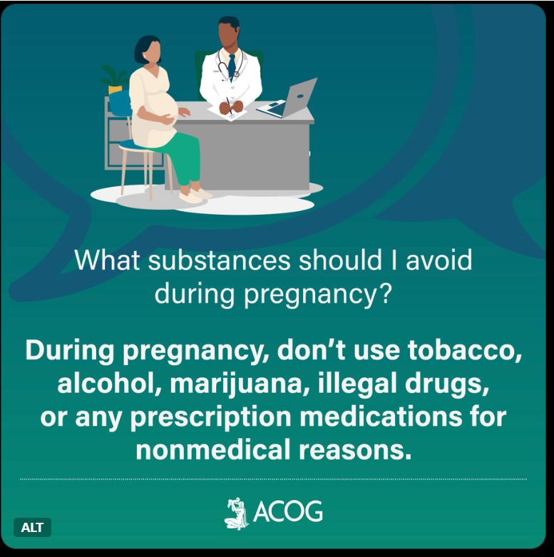
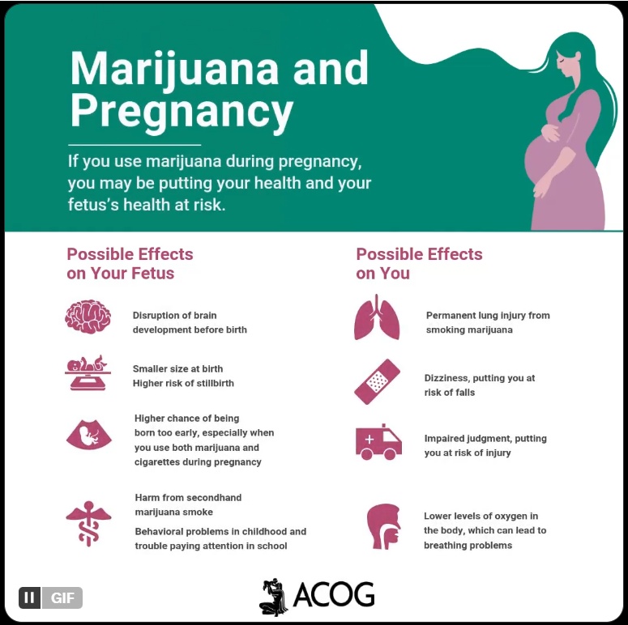
NPN’s Most Viewed X Posts
FASD United – 5,327 views
Alcohol Awareness Month
(April 2024)
ACOG – 2,418 views
National Alcohol and Other Drug-Related Birth Defects Awareness Week (May 2023)
ACOG – 2,347 views
(March 2023)

Slide 19
NPN’s Average Daily Reach (all channels)
Highest peaks were a result of increased posts during FASD Awareness month in September 2023 and 2024.
naswsocialworkers had high-reaching Facebook posts in May 2023 and during both FASD Awareness Months (Link to appendix)
ameracadpeds had high-reaching Facebook posts during 2024 FASD Awareness Month. (Link to appendix

Slide 20
NPN’s Average Posts Per Day (all channels)
FASD Awareness Month 2023
Birth Defects Awareness Month
FASD Awareness Month 2024

Slide 21
Engagements and Views by NPN Authors
FASD United had the most engagements/views for all three channels, followed by ACOG (for Instagram and X/Twitter) and NASW. Eleven NPN organizations are listed below.
14,444
engagements
9,374
engagements
69,401 views
Instagram Author | Engagements
@fasdunited | 7,307
@acog_org | 4,594
@medicalassistantpartnership | 878
@naswsocialworkers | 742
@awhonn | 573
@acnmmidwives | 117
Facebook Author | Engagements
fasdunited | 8,126
aamaorg | 350
naswsocialworkers | 277
oakridgeassociateduniversities (ORAU) | 192
awhonn | 179
familymed (AAFP) | 129
X/Twitter Author | Views
@fasdunited | 27,046
@acog | 18,801
@nasw | 17,746
@aafp | 2,483
@NACCHOalerts | 1,579
@mapfasd | 1,050

Slide 22
Social Media Posts Using #FASDNPN Hashtag

Slide 23
#FASDNPN Use Across 4 Platforms
614 original* social media posts included #FASDNPN from September 2023 through September 2024
Top platforms:
Instagram (43%, n=262)
X/Twitter (39%, n=239)
* Original posts do not include shared posts or quoted posts on X/Twitter

Slide 24
Content Themes of Instagram Posts with #FASDNPN
Two ORAU analysts performed a selective content analysis of 151 Instagram posts with a unique* message
The most common theme (38%) focused on raising awareness about FASD and alcohol
* When multiple posts featured the same text (e.g., Let's Talk post captions, captions taken from an NPN Toolkit) only one of the repetitive posts were included in the content analysis. Analysts did this to minimize content duplication.

Slide 25
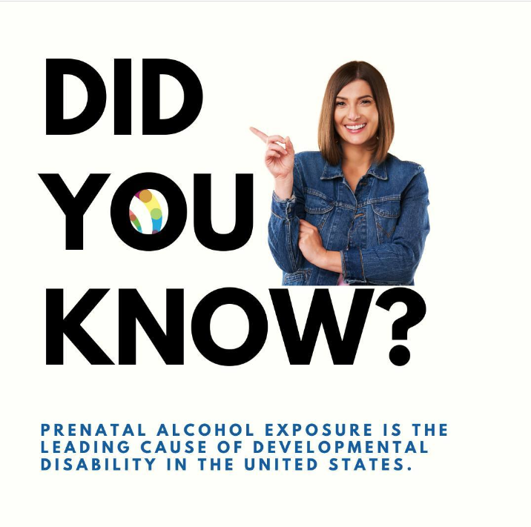
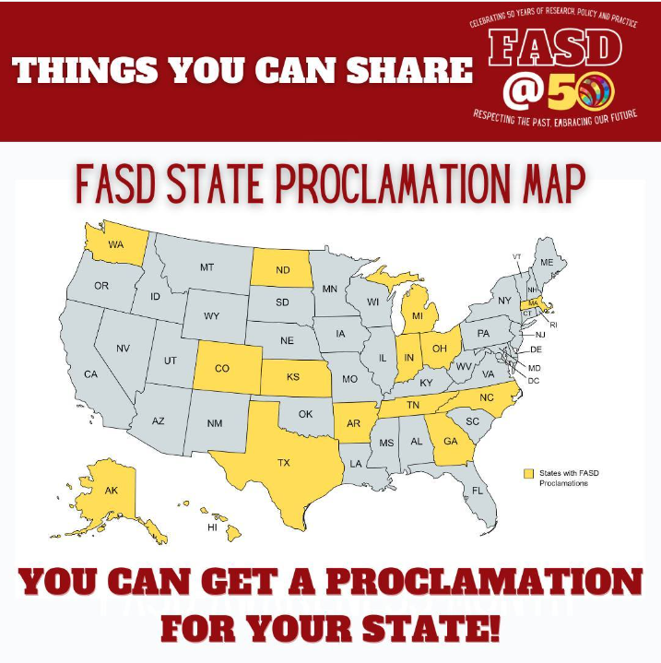
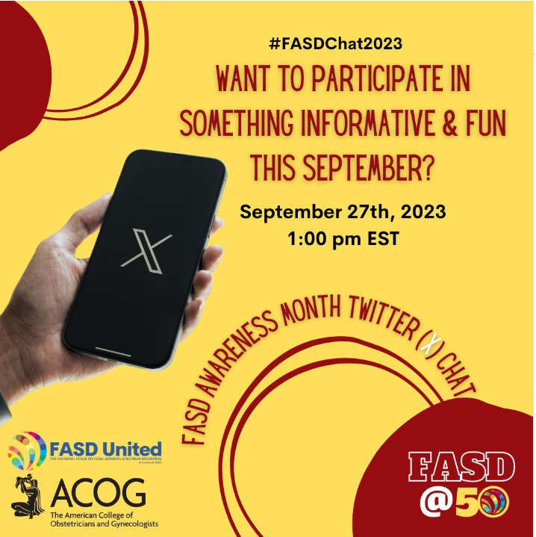
Content Themes of Instagram Posts with #FASDNPN – Examples
FASD NPN and Organizational Highlights
@ACOG: Learn about the risks of alcohol use during pregnancy, fetal alcohol spectrum disorders prevention, and more during our #FASDAwareness Month chat with @fasdunited and the @cdcgov National Center on Birth Defects and Developmental Disabilities. Use #FASDChat2023 on X (formerly Twitter) to join the conversation September 27 at 1 p.m. ET. #FASDNPN
Professional Development and Research
@Naswsocialworkers: It’s National Women’s Health Week! Social workers can help women prioritize their health by making conversations about alcohol use part of routine practice. Here are three key messages to share with clients: https://bit.ly/4dxdX2n #NASW #NWHW #MothersDay #FASDNPN @TexasSteveHicks @womenshealth @CDCgov
FASD and Alcohol General Awareness
@FASD United: Birth defects and developmental disabilities affect individuals throughout their lifespan. Ever wondered what the labels on liquor bottles mean when they say, "alcohol can cause birth defects?" Learn more about FASD this January. #birthdefectsawareness #FASDNPN
Community Support, Advocacy, and Policy
@FASD United: State proclamations for #FASD are the perfect way to celebrate #FASDAwareness Month! Here are where they exist so far...want to secure yours? #FASDNPN. Use our linktree in bio to access the Policy Center and "State Policy."

Slide 26
Authors of Original* Posts Mentioning #FASDNPN (n=614)
NPN organizations authored 67% of posts
American Academy of Family Physicians (AAFP) State Chapters authored 27% of posts
National Association of Social Workers (NASW) State Chapters authored 5% of posts
Other authors (1%) included individuals and organizations not affiliated with the NPN (e.g., Indiana Alliance on Prenatal Substance Exposure)
Author Count by Platform | Instagram | X/ Twitter | LinkedIn | Facebook
NPN | 10 | 10 | 9 | 10
State AAFP | 10 | 14 | 4 | ‡
State NASW | 13 | 5 | 2 | ‡
Other | 2 | 1 | 2 | ‡
* Original posts do not include shared posts or quoted posts on X/Twitter
‡ Did not monitor Facebook accounts of these organizations

Slide 27
AAFP’s State Chapters’ Social Media Posts Including #FASDNPN (n=164)
The most posts came from these AAFP state chapters:
Louisiana
New Jersey
Missouri
Utah
New York

Slide 28
NASW State Chapters’ Social Media Posts Including #FASDNPN (n=31)
The most posts came from these NASW state chapters:
Wisconsin
Indiana
Hawaii

Slide 29
Monthly Use of #FASDNPN

Slide 30
Hashtags Used Alongside #FASDNPN
Word size reflects hashtag use frequency (6–58 instances)
Notes:
Hashtag Count
#FASDAwarenessMonth 58
#Momosas 56
#WomenAndAlcohol 56
#NASW 55
#FASD 54
#FASDAwareness 51
#birthdefectsawareness 47
#FASDMonth 47
#birthdefects 33
#NDAFW 30
#FASDChat2023 19
#NWHW 15
#FASDay 14
#fafp 11
#aafp 10
#FASD50 10
#SocialWorkers 9
#MothersDay 9
#alcohol 8
#healthcare 8
#medicalassistants 7
#AlcoholAwarenessMonth 6

Slide 31
Post Volume, Engagements, and Views by Top NPN Authors
Medical Assistant Partnership and FASD United used the hashtag most. FASD United’s posts had the most Instagram engagements and X/Twitter views.
2,046
engagements
422
engagements
28,695 views
Instagram Author | Posts | Engagements
@medicalassistantpartnership (MAP) | 77 posts | 398 engagements
@fasdunited | 50 posts | 880 engagements
@casatunr | 23 posts | 156 engagements
Facebook Author | Posts | Engagements
oakridgeassociateduniversities (ORAU) | 6 posts | 29 engagements
naswsocialworkers (NASW) | 5 posts | 95 engagements
npwh1 | 5 posts | 2 engagements
fasdunited | 4 posts | 88 engagements
X/Twitter Author | Posts | Views
@mapfasd | 63 posts| 3,003 views
@fasdunited | 45 posts | 10,002 views
@lafp_familydocs | 15 posts | 414 views

Slide 32
Volume and Engagement by Media Type*
Instagram and Facebook posts containing #FASDNPN included 12 different types of media including NPN organizations’ custom images, NPN Toolkit images, CDC images (e.g., Let’s Talk materials), animations, and videos. See appendix for examples.
* Engagement data alongside post counts reveal patterns; however, caution is advised in overinterpreting, as engagements can be shaped by factors such as the poster’s reach and influence.

Slide 33
X/Twitter Volume and Views by Media Type
See appendix for media type descriptions and examples

Slide 34
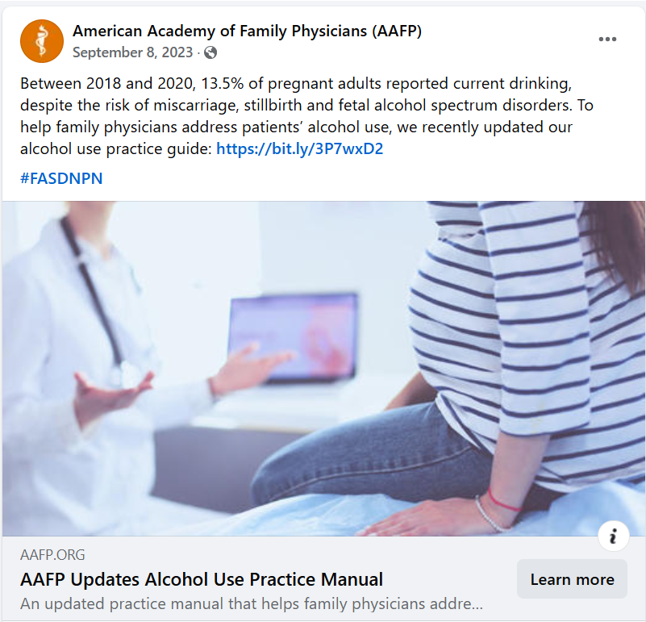
Most Engaging Social Media Posts
AAFP’s post on Facebook had 111 engagements and a reach of 76,924.
Most of the engagements were comments (n=92), which far exceeded their usual level of engagement (average 32) about this topic.
Comments reflected a mix of shock about the statistic, concern for terminology (“pregnant adults”), emphasis on personal responsibility, debates over rights versus societal impact, and professional insights into the consequences of prenatal alcohol exposure.

Slide 35
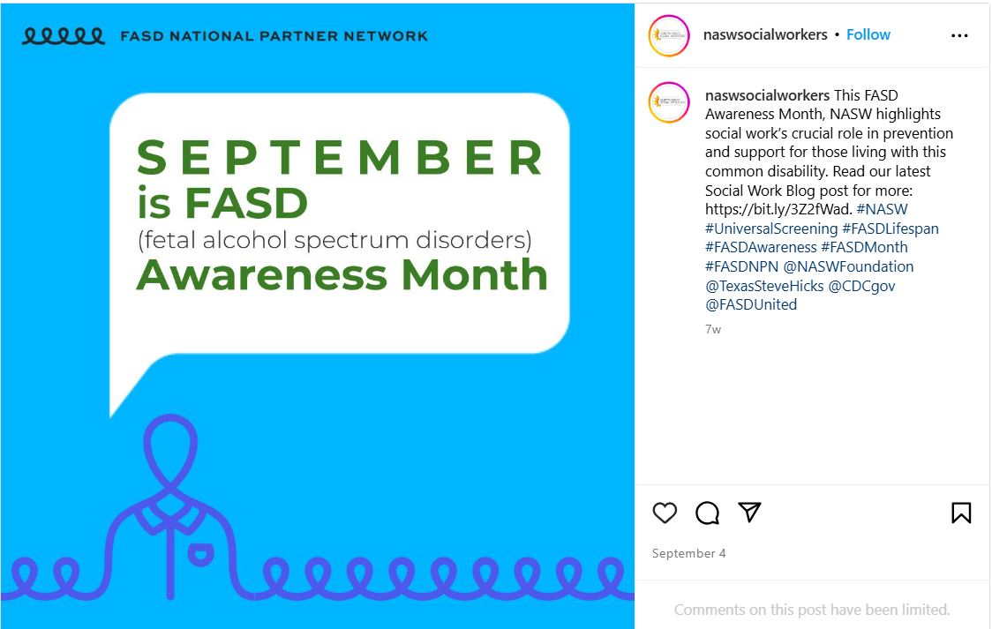
Most Engaging Social Media Posts
NASW’s Instagram post, featuring an FASD NPN Toolkit image during FASD Awareness Month (September 2024), garnered 98 positive reactions and reached 54,177 viewers (yet received no comments).
The post tagged 4 accounts to enhance visibility, potentially contributing to its higher-than-average engagement levels (average 36) on this topic.

Slide 36
Most Engaging Social Media Posts
This NASW Instagram post, featuring an original photo, achieved 95 engagements—primarily reactions—and reached 53,049 viewers. This surpassed the average engagement of 36 for similar topics, despite receiving minimal comments.

Slide 37
Actions to Consider

Slide 38
Actions to Enhance NPN Communication Efforts
Continue to use #FASDNPN in your posts to enhance their engagement and visibility
Share Communications Bulletins with your local chapters and relevant groups to extend the reach of important FASD awareness messages.
Suggest ideas and topics for future "Quick Tips" in the Communications Bulletins.

Slide 39
Appendix

Slide 40
High-Reach Posts by NASW (naswsocialworkers)
May 2023
Did you know women face greater health risks from drinking than men do? In honor of National Women’s Health Week, learn more about how social work can lead in this public health issue… (2 posts with different images)
Social workers: Celebrate National Women’s Health Week by starting the conversation about alcohol use with women, including those who are or may become pregnant. It takes just a few minutes to make a difference… (2 posts with different images)
Preventing Fetal Alcohol Spectrum Disorders. In the latest NASW podcast, we speak with Dr. Mary Velasquez and Anna Magnum about National Partnerships to Address Prenatal Alcohol and other Substance Use and Fetal Alcohol Spectrum Disorders, the Centers for Disease Control grant that began October 2023 in partnership with the University of Texas at Austin…
The Social Work Advocates April / May 2023 Issue is Now Available! To find articles on Aging Out of Foster Care, Preventing Fetal Alcohol Spectrum Disorders, and much more,..
September 2023
How common is drinking during pregnancy? What are fetal alcohol spectrum disorders (FASDs)? Read our Social Work Blog post for the answers ...
September 2024
This FASD Awareness Month, NASW highlights social work’s crucial role in prevention and support for those living with this common disability. Read our latest Social Work Blog post for more…

Slide 41
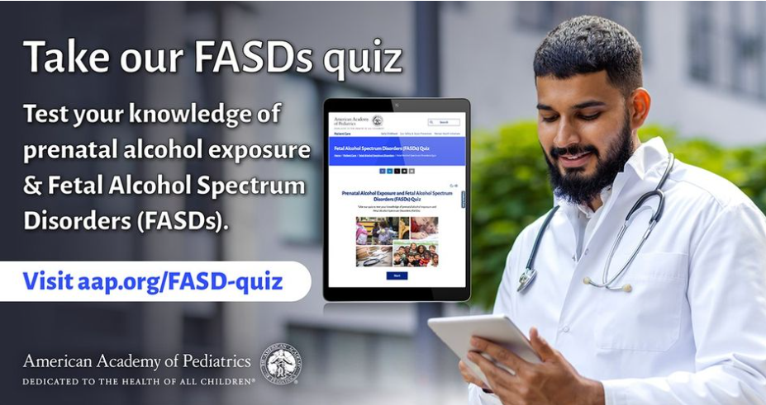
High-Reach Posts by AAP (ameracadpeds)
September 2024
Neurocognitive and behavioral problems resulting from prenatal alcohol exposure are lifelong. AAP advises that pediatricians adopt universal screening into their routine office visits so that treatments may start early. Learn more during FASD Awareness Month…
Check out AAP’s new quiz to test your knowledge of prenatal alcohol exposure and FASDs during FASD Awareness Month…
Research has shown that early identification and management of fetal alcohol spectrum disorders (FASDs) can significantly improve a child's development and improve life outcomes. Learn more during FASD Awareness Month and take our quiz…

Slide 42
Media Types – Examples
Media Type (Link to Example) | Description
NPN org’s image (example) | An image often including text that the NPN organization customized or developed
NPN Toolkit image (example) | An image provided on the FASD NPN Toolkit
Stock photo (example) | An image without text that resembles stock photography
Partner post of NPN org's image (example) | An image developed by another NPN organization (see NPN org’s image) that was reposted. The example was an FASD United image posted by AAMA.
CDC image (example) | An image including the CDC logo or branding, such as Let’s Talk materials
FASD Video Series 2024 (example) | A video from the FASD video series 2024
No image (example)
Other org's image (not NPN) (example) | A reposted image originally posted by a non-NPN organization
Original photo (example) | A candid photo that often includes people
NPN Spotlight Series animation (example) | An animation produced by FASD United for their NPN Spotlight Series
Resource screenshot (example) | A screenshot of an article or other resource

